Slide 1
SEQUENTIAL CIRCUIT DESIGN
EXAMPLE 1 using D Flip Flop
LECTURE 8

Slide 2
STEPS FOR SEQUENTIAL CIRCUIT DESIGN
State Diagram
State Reduction And Assignment
Next State Table
Flip Flop Transition Table (FLIP FLOP Selection)
Simplification
Input/output Equations
Implementations of Equation(Logic Diagram)

Slide 3
STATE DIAGRAM
00
11
01
10

Slide 4
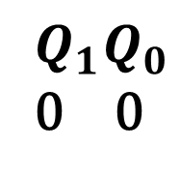
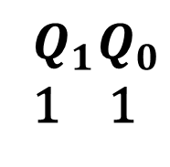
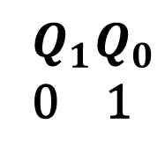
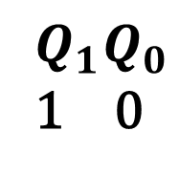
STATE DIAGRAM

Slide 5
NEXT STATE TABLE
PRESENT STATE |  | NEXT STATE
0 | 0 | 0 | 1
0 | 1 | 1 | 0
1 | 0 | 1 | 1
1 | 1 | 0 | 0

Slide 6
NEXT STATE TABLE USING D FLIP FLOP
 |  | D
0 | 0 | 0
0 | 1 | 1
1 | 0 | 0
1 | 1 | 1
PRESENT STATE |  | NEXT STATE |  | D FLIP FLOP INPUTS
0 | 0 | 0 | 1 | 0
0 | 1 | 1 | 0
1 | 0 | 1 | 1
1 | 1 | 0 | 0

Slide 7
NEXT STATE TABLE USING D FLIP FLOP
 |  | D
0 | 0 | 0
0 | 1 | 1
1 | 0 | 0
1 | 1 | 1
PRESENT STATE |  | NEXT STATE |  | D FLIP FLOP INPUTS
0 | 0 | 0 | 1 | 0
0 | 1 | 1 | 0 | 1
1 | 0 | 1 | 1
1 | 1 | 0 | 0

Slide 8
NEXT STATE TABLE USING D FLIP FLOP
 |  | D
0 | 0 | 0
0 | 1 | 1
1 | 0 | 0
1 | 1 | 1
PRESENT STATE |  | NEXT STATE |  | D FLIP FLOP INPUTS
0 | 0 | 0 | 1 | 0
0 | 1 | 1 | 0 | 1
1 | 0 | 1 | 1 | 1
1 | 1 | 0 | 0

Slide 9
NEXT STATE TABLE USING D FLIP FLOP
 |  | D
0 | 0 | 0
0 | 1 | 1
1 | 0 | 0
1 | 1 | 1
PRESENT STATE |  | NEXT STATE |  | D FLIP FLOP INPUTS
0 | 0 | 0 | 1 | 0
0 | 1 | 1 | 0 | 1
1 | 0 | 1 | 1 | 1
1 | 1 | 0 | 0 | 0

Slide 10
NEXT STATE TABLE USING D FLIP FLOP
 |  | D
0 | 0 | 0
0 | 1 | 1
1 | 0 | 0
1 | 1 | 1
PRESENT STATE |  | NEXT STATE |  | D FLIP FLOP INPUTS
0 | 0 | 0 | 1 | 0 | 1
0 | 1 | 1 | 0 | 1
1 | 0 | 1 | 1 | 1
1 | 1 | 0 | 0 | 0

Slide 11
NEXT STATE TABLE USING D FLIP FLOP
 |  | D
0 | 0 | 0
0 | 1 | 1
1 | 0 | 0
1 | 1 | 1
PRESENT STATE |  | NEXT STATE |  | D FLIP FLOP INPUTS
0 | 0 | 0 | 1 | 0 | 1
0 | 1 | 1 | 0 | 1 | 0
1 | 0 | 1 | 1 | 1
1 | 1 | 0 | 0 | 0

Slide 12
NEXT STATE TABLE USING D FLIP FLOP
 |  | D
0 | 0 | 0
0 | 1 | 1
1 | 0 | 0
1 | 1 | 1
PRESENT STATE |  | NEXT STATE |  | D FLIP FLOP INPUTS
0 | 0 | 0 | 1 | 0 | 1
0 | 1 | 1 | 0 | 1 | 0
1 | 0 | 1 | 1 | 1 | 1
1 | 1 | 0 | 0 | 0

Slide 13
NEXT STATE TABLE USING D FLIP FLOP
 |  | D
0 | 0 | 0
0 | 1 | 1
1 | 0 | 0
1 | 1 | 1
PRESENT STATE |  | NEXT STATE |  | D FLIP FLOP INPUTS
0 | 0 | 0 | 1 | 0 | 1
0 | 1 | 1 | 0 | 1 | 0
1 | 0 | 1 | 1 | 1 | 1
1 | 1 | 0 | 0 | 0 | 0

Slide 14
SIMPLIFICATION(K-MAP)
PRESENT STATE |  | NEXT STATE |  | D FLIP FLOP INPUTS
0 | 0 | 0 | 1 | 0 | 1
0 | 1 | 1 | 0 | 1 | 0
1 | 0 | 1 | 1 | 1 | 1
1 | 1 | 0 | 0 | 0 | 0
 |  | 0 | 1
 | 0 | 0 | 1
 | 1 | 1 | 0

Slide 15
SIMPLIFICATION(K-MAP)
PRESENT STATE |  | D FLIP FLOP INPUTS
0 | 0 | 0 | 1
0 | 1 | 1 | 0
1 | 0 | 1 | 1
1 | 1 | 0 | 0
 |  | 0 | 1
 | 0 | 0 | 1
 | 1 | 1 | 0

Slide 16
SIMPLIFICATION(K-MAP)
PRESENT STATE |  | NEXT STATE |  | D FLIP FLOP INPUTS
0 | 0 | 0 | 1 | 0 | 1
0 | 1 | 1 | 0 | 1 | 0
1 | 0 | 1 | 1 | 1 | 1
1 | 1 | 0 | 0 | 0 | 0
 |  | 0 | 1
 | 0 | 0 | 1
 | 1 | 1 | 0
 |  | 0 | 1
 | 0 | 1 | 0
 | 1 | 1 | 0

Slide 17
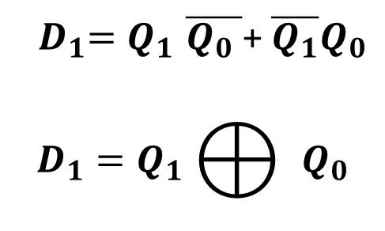
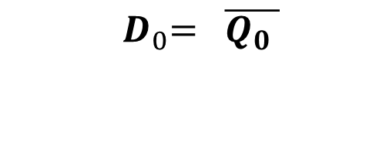
INPUT EQUATIONS
 |  | 0 | 1
 | 0 | 0 | 1
 | 1 | 1 | 0
 |  | 0 | 1
 | 0 | 1 | 0
 | 1 | 1 | 0

Slide 18
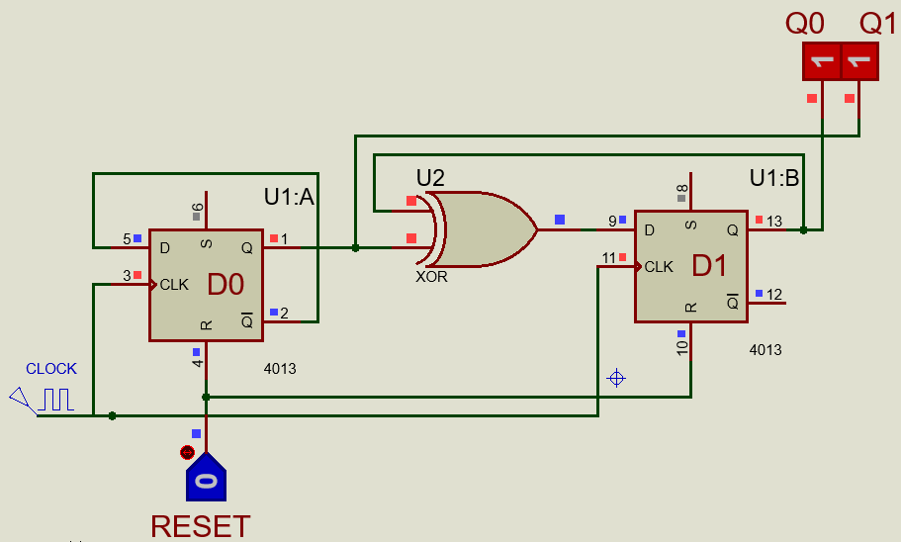
IMPLEMENTATIONS OF EQUATION

Slide 19
SEQUENTIAL CIRCUIT DESIGN
EXAMPLE 1 using T Flip Flop
LECTURE 8

Slide 20
STEPS FOR SEQUENTIAL CIRCUIT DESIGN
State Diagram
Next State Table
State Reduction And Assignment
Flip Flop Transition Table (FLIP FLOP Selection)
Simplification
Input/output Equations
Implementations of Equation(Logic Diagram)

Slide 21
STATE DIAGRAM
00
11
01
10

Slide 22
STATE DIAGRAM

Slide 23
NEXT STATE TABLE
PRESENT STATE |  | NEXT STATE
0 | 0 | 0 | 1
0 | 1 | 1 | 0
1 | 0 | 1 | 1
1 | 1 | 0 | 0

Slide 24
NEXT STATE TABLE USING T FLIP FLOP
 |  | T
0 | 0 | 0
0 | 1 | 1
1 | 0 | 1
1 | 1 | 0
PRESENT STATE |  | NEXT STATE |  | T FLIP FLOP INPUTS
0 | 0 | 0 | 1 | 0
0 | 1 | 1 | 0
1 | 0 | 1 | 1
1 | 1 | 0 | 0

Slide 25
NEXT STATE TABLE USING T FLIP FLOP
 |  | T
0 | 0 | 0
0 | 1 | 1
1 | 0 | 1
1 | 1 | 0
PRESENT STATE |  | NEXT STATE |  | T FLIP FLOP INPUTS
0 | 0 | 0 | 1 | 0
0 | 1 | 1 | 0 | 1
1 | 0 | 1 | 1
1 | 1 | 0 | 0

Slide 26
NEXT STATE TABLE USING T FLIP FLOP
 |  | T
0 | 0 | 0
0 | 1 | 1
1 | 0 | 1
1 | 1 | 0
PRESENT STATE |  | NEXT STATE |  | T FLIP FLOP INPUTS
0 | 0 | 0 | 1 | 0
0 | 1 | 1 | 0 | 1
1 | 0 | 1 | 1 | 0
1 | 1 | 0 | 0

Slide 27
NEXT STATE TABLE USING T FLIP FLOP
 |  | T
0 | 0 | 0
0 | 1 | 1
1 | 0 | 1
1 | 1 | 0
PRESENT STATE |  | NEXT STATE |  | T FLIP FLOP INPUTS
0 | 0 | 0 | 1 | 0
0 | 1 | 1 | 0 | 1
1 | 0 | 1 | 1 | 0
1 | 1 | 0 | 0 | 1

Slide 28
NEXT STATE TABLE USING T FLIP FLOP
 |  | T
0 | 0 | 0
0 | 1 | 1
1 | 0 | 1
1 | 1 | 0
PRESENT STATE |  | NEXT STATE |  | T FLIP FLOP INPUTS
0 | 0 | 0 | 1 | 0 | 1
0 | 1 | 1 | 0 | 1
1 | 0 | 1 | 1 | 0
1 | 1 | 0 | 0 | 1

Slide 29
NEXT STATE TABLE USING T FLIP FLOP
 |  | T
0 | 0 | 0
0 | 1 | 1
1 | 0 | 1
1 | 1 | 0
PRESENT STATE |  | NEXT STATE |  | T FLIP FLOP INPUTS
0 | 0 | 0 | 1 | 0 | 1
0 | 1 | 1 | 0 | 1 | 1
1 | 0 | 1 | 1 | 0
1 | 1 | 0 | 0 | 1

Slide 30
NEXT STATE TABLE USING T FLIP FLOP
 |  | T
0 | 0 | 0
0 | 1 | 1
1 | 0 | 1
1 | 1 | 0
PRESENT STATE |  | NEXT STATE |  | T FLIP FLOP INPUTS
0 | 0 | 0 | 1 | 0 | 1
0 | 1 | 1 | 0 | 1 | 1
1 | 0 | 1 | 1 | 0 | 1
1 | 1 | 0 | 0 | 1

Slide 31
NEXT STATE TABLE USING T FLIP FLOP
 |  | T
0 | 0 | 0
0 | 1 | 1
1 | 0 | 1
1 | 1 | 0
PRESENT STATE |  | NEXT STATE |  | T FLIP FLOP INPUTS
0 | 0 | 0 | 1 | 0 | 1
0 | 1 | 1 | 0 | 1 | 1
1 | 0 | 1 | 1 | 0 | 1
1 | 1 | 0 | 0 | 1 | 1

Slide 32
NEXT STATE TABLE USING T FLIP FLOP
PRESENT STATE |  | NEXT STATE |  | T FLIP FLOP INPUTS
0 | 0 | 0 | 1 | 0 | 1
0 | 1 | 1 | 0 | 1 | 1
1 | 0 | 1 | 1 | 0 | 1
1 | 1 | 0 | 0 | 1 | 1

Slide 33
SIMPLIFICATION(K-MAP)
PRESENT STATE |  | NEXT STATE |  | T FLIP FLOP INPUTS
0 | 0 | 0 | 1 | 0 | 1
0 | 1 | 1 | 0 | 1 | 1
1 | 0 | 1 | 1 | 0 | 1
1 | 1 | 0 | 0 | 1 | 1
 |  | 0 | 1
 | 0 | 0 | 1
 | 1 | 0 | 1
 |  | 0 | 1
 | 0 | 1 | 1
 | 1 | 1 | 1

Slide 34
INPUT EQUATIONS
PRESENT STATE |  | NEXT STATE |  | T FLIP FLOP INPUTS
0 | 0 | 0 | 1 | 0 | 1
0 | 1 | 1 | 0 | 1 | 1
1 | 0 | 1 | 1 | 0 | 1
1 | 1 | 0 | 0 | 1 | 1
 |  | 0 | 1
 | 0 | 0 | 1
 | 1 | 0 | 1
 |  | 0 | 1
 | 0 | 1 | 1
 | 1 | 1 | 1

Slide 35
IMPLEMENTATIONS OF EQUATION

Slide 36
SEQUENTIAL CIRCUIT DESIGN
EXAMPLE 1 (2 BIT SYNCHRONOUS COUNTER) using JK Flip Flop
LECTURE 8

Slide 37
STEPS FOR SEQUENTIAL CIRCUIT DESIGN
State Diagram
Next State Table
State Reduction And Assignment
Flip Flop Transition Table (FLIP FLOP Selection)
Simplification
Input/output Equations
Implementations of Equation(Logic Diagram)

Slide 38
STATE DIAGRAM
00
11
01
10

Slide 39
STATE DIAGRAM

Slide 40
NEXT STATE TABLE
PRESENT STATE |  | NEXT STATE
0 | 0 | 0 | 1
0 | 1 | 1 | 0
1 | 0 | 1 | 1
1 | 1 | 0 | 0

Slide 41
NEXT STATE TABLE USING JK FLIP FLOP
 |  | J | K
0 | 0 | 0 | X
0 | 1 | 1 | X
1 | 0 | X | 1
1 | 1 | X | 0

Slide 42
NEXT STATE TABLE USING JK FLIP FLOP
 |  | J | K
0 | 0 | 0 | X
0 | 1 | 1 | X
1 | 0 | X | 1
1 | 1 | X | 0
PRESENT STATE |  | NEXT STATE |  | JK FLIP FLOP INPUTS
0 | 0 | 0 | 1 | 0 | X
0 | 1 | 1 | 0
1 | 0 | 1 | 1
1 | 1 | 0 | 0

Slide 43
NEXT STATE TABLE USING JK FLIP FLOP
 |  | J | K
0 | 0 | 0 | X
0 | 1 | 1 | X
1 | 0 | X | 1
1 | 1 | X | 0
PRESENT STATE |  | NEXT STATE |  | JK FLIP FLOP INPUTS
0 | 0 | 0 | 1 | 0 | X
0 | 1 | 1 | 0
1 | 0 | 1 | 1
1 | 1 | 0 | 0

Slide 44
NEXT STATE TABLE USING JK FLIP FLOP
 |  | J | K
0 | 0 | 0 | X
0 | 1 | 1 | X
1 | 0 | X | 1
1 | 1 | X | 0
PRESENT STATE |  | NEXT STATE |  | JK FLIP FLOP INPUTS
0 | 0 | 0 | 1 | 0 | X
0 | 1 | 1 | 0 | 1 | X
1 | 0 | 1 | 1
1 | 1 | 0 | 0

Slide 45
NEXT STATE TABLE USING JK FLIP FLOP
 |  | J | K
0 | 0 | 0 | X
0 | 1 | 1 | X
1 | 0 | X | 1
1 | 1 | X | 0
PRESENT STATE |  | NEXT STATE |  | JK FLIP FLOP INPUTS
0 | 0 | 0 | 1 | 0 | X
0 | 1 | 1 | 0 | 1 | X
1 | 0 | 1 | 1 | X | 0
1 | 1 | 0 | 0

Slide 46
NEXT STATE TABLE USING JK FLIP FLOP
 |  | J | K
0 | 0 | 0 | X
0 | 1 | 1 | X
1 | 0 | X | 1
1 | 1 | X | 0
PRESENT STATE |  | NEXT STATE |  | JK FLIP FLOP INPUTS
0 | 0 | 0 | 1 | 0 | X
0 | 1 | 1 | 0 | 1 | X
1 | 0 | 1 | 1 | X | 0
1 | 1 | 0 | 0 | X | 1

Slide 47
NEXT STATE TABLE USING JK FLIP FLOP
 |  | J | K
0 | 0 | 0 | X
0 | 1 | 1 | X
1 | 0 | X | 1
1 | 1 | X | 0
PRESENT STATE |  | NEXT STATE |  | JK FLIP FLOP INPUTS
0 | 0 | 0 | 1 | 0 | X | 1 | X
0 | 1 | 1 | 0 | 1 | X
1 | 0 | 1 | 1 | X | 0
1 | 1 | 0 | 0 | X | 1

Slide 48
NEXT STATE TABLE USING JK FLIP FLOP
 |  | J | K
0 | 0 | 0 | X
0 | 1 | 1 | X
1 | 0 | X | 1
1 | 1 | X | 0
PRESENT STATE |  | NEXT STATE |  | JK FLIP FLOP INPUTS
0 | 0 | 0 | 1 | 0 | X | 1 | X
0 | 1 | 1 | 0 | 1 | X | X | 1
1 | 0 | 1 | 1 | X | 0
1 | 1 | 0 | 0 | X | 1

Slide 49
NEXT STATE TABLE USING JK FLIP FLOP
 |  | J | K
0 | 0 | 0 | X
0 | 1 | 1 | X
1 | 0 | X | 1
1 | 1 | X | 0
PRESENT STATE |  | NEXT STATE |  | JK FLIP FLOP INPUTS
0 | 0 | 0 | 1 | 0 | X | 1 | X
0 | 1 | 1 | 0 | 1 | X | X | 1
1 | 0 | 1 | 1 | X | 0 | 1 | X
1 | 1 | 0 | 0 | X | 1

Slide 50
NEXT STATE TABLE USING JK FLIP FLOP
 |  | J | K
0 | 0 | 0 | X
0 | 1 | 1 | X
1 | 0 | X | 1
1 | 1 | X | 0
PRESENT STATE |  | NEXT STATE |  | JK FLIP FLOP INPUTS
0 | 0 | 0 | 1 | 0 | X | 1 | X
0 | 1 | 1 | 0 | 1 | X | X | 1
1 | 0 | 1 | 1 | X | 0 | 1 | X
1 | 1 | 0 | 0 | X | 1 | X | 1

Slide 51
NEXT STATE TABLE USING JK FLIP FLOP
 |  | J | K
0 | 0 | 0 | X
0 | 1 | 1 | X
1 | 0 | X | 1
1 | 1 | X | 0
PRESENT STATE |  | JK FLIP FLOP INPUTS
0 | 0 | 0 | X | 1 | X
0 | 1 | 1 | X | X | 1
1 | 0 | X | 0 | 1 | X
1 | 1 | X | 1 | X | 1

Slide 52
NEXT STATE TABLE USING JK FLIP FLOP
PRESENT STATE |  | JK FLIP FLOP INPUTS
0 | 0 | 0 | X | 1 | X
0 | 1 | 1 | X | X | 1
1 | 0 | X | 0 | 1 | X
1 | 1 | X | 1 | X | 1

Slide 53
SIMPLIFICATION(K-MAP)
PRESENT STATE |  | NEXT STATE |  | JK FLIP FLOP INPUTS
0 | 0 | 0 | 1 | 0 | X | 1 | X
0 | 1 | 1 | 0 | 1 | X | X | 1
1 | 0 | 1 | 1 | X | 0 | 1 | X
1 | 1 | 0 | 0 | X | 1 | X | 1
 |  | 0 | 1
 | 0 | 0 | 1
 | 1 | X | X
 |  | 0 | 1
 | 0
 | 1
 |  | 0 | 1
 | 0
 | 1
 |  | 0 | 1
 | 0
 | 1

Slide 54
SIMPLIFICATION(K-MAP)
PRESENT STATE |  | NEXT STATE |  | JK FLIP FLOP INPUTS
0 | 0 | 0 | 1 | 0 | X | 1 | X
0 | 1 | 1 | 0 | 1 | X | X | 1
1 | 0 | 1 | 1 | X | 0 | 1 | X
1 | 1 | 0 | 0 | X | 1 | X | 1
 |  | 0 | 1
 | 0 | 0 | 1
 | 1 | X | X
 |  | 0 | 1
 | 0 | 1 | X
 | 1 | 1 | X
 |  | 0 | 1
 | 0
 | 1
 |  | 0 | 1
 | 0
 | 1

Slide 55
SIMPLIFICATION(K-MAP)
PRESENT STATE |  | NEXT STATE |  | JK FLIP FLOP INPUTS
0 | 0 | 0 | 1 | 0 | X | 1 | X
0 | 1 | 1 | 0 | 1 | X | X | 1
1 | 0 | 1 | 1 | X | 0 | 1 | X
1 | 1 | 0 | 0 | X | 1 | X | 1
 |  | 0 | 1
 | 0 | 0 | 1
 | 1 | X | X
 |  | 0 | 1
 | 0 | 1 | X
 | 1 | 1 | X
 |  | 0 | 1
 | 0 | X | X
 | 1 | 0 | 1
 |  | 0 | 1
 | 0
 | 1

Slide 56
SIMPLIFICATION(K-MAP)
PRESENT STATE |  | NEXT STATE |  | JK FLIP FLOP INPUTS
0 | 0 | 0 | 1 | 0 | X | 1 | X
0 | 1 | 1 | 0 | 1 | X | X | 1
1 | 0 | 1 | 1 | X | 0 | 1 | X
1 | 1 | 0 | 0 | X | 1 | X | 1
 |  | 0 | 1
 | 0 | 0 | 1
 | 1 | X | X
 |  | 0 | 1
 | 0 | 1 | X
 | 1 | 1 | X
 |  | 0 | 1
 | 0 | X | X
 | 1 | 0 | 1
 |  | 0 | 1
 | 0 | X | 1
 | 1 | X | 1

Slide 57
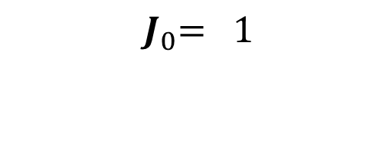
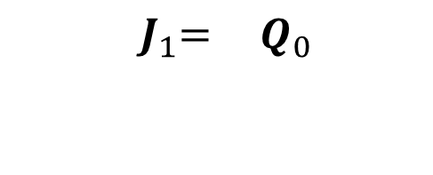
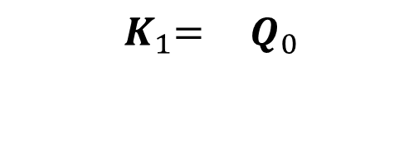
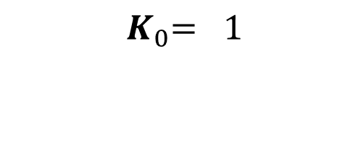
INPUT EQUATIONS
 |  | 0 | 1
 | 0 | 1 | X
 | 1 | 1 | X
 |  | 0 | 1
 | 0 | 0 | 1
 | 1 | X | X
 |  | 0 | 1
 | 0 | X | 1
 | 1 | X | 1
 |  | 0 | 1
 | 0 | X | X
 | 1 | 0 | 1

Slide 58
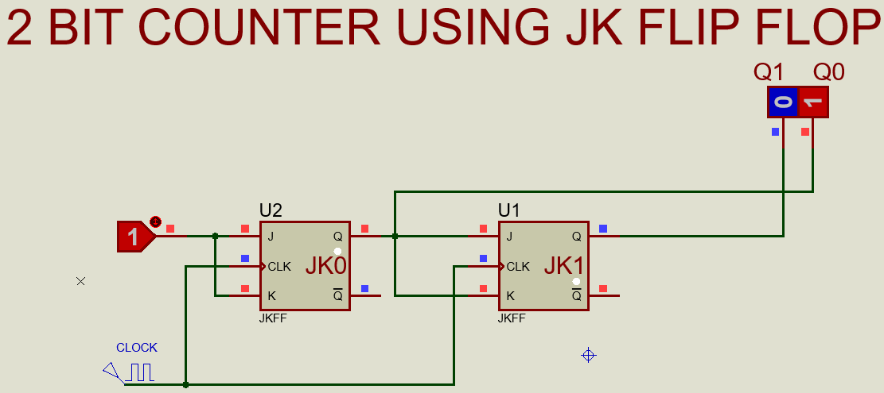
IMPLEMENTATIONS OF EQUATION

